Slide 1
Advance Java
Jsp Page Processing

Slide 2
What is jsp ?
Jsp is essentially Source code, and must be Converted into servlet before it can service requests.
Life cycle
Translate jsp to servlet
Compile sservlet to bytecode
Load the servlet class
Creates the servlet instance
Call jspinit() method
Call the _jspService method
Call the jspdestroy
Interfaces used
HttpJspPage
Methods of it is
jspinit()
_jspService()
jspdestroy()

Slide 3
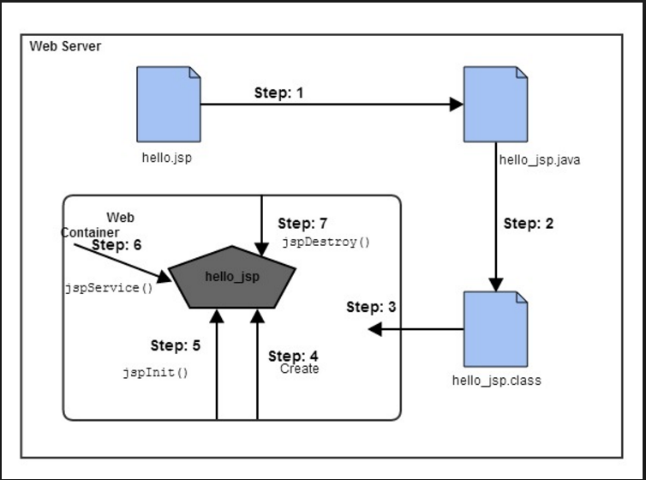

Slide 4
For example
Count.jsp
<html>
<head>
<title>My First JSP Page</title>
</head>
<% int count = 0; %>
<body>
Page Count is:
<% out.println(++count); %>
</body> </html>

Slide 5
It will be converted in
public class Count_jsp extends HttpServlet {
public void _jspService(HttpServletRequest request, HttpServletResponse response) throws IOException,ServletException
{
PrintWriter out = response.getWriter(); response.setContenType("text/html"); out.write("<html><body>");
int count=0; out.write("Page count is:"); out.print(++count); out.write("</body></html>");
}
}

